Slide 1
Introduction to Python
Class 2

Slide 2
Review: Python Data Types
Numbers: integers, floats, long, complex numbers
Strings: Text, special characters, Unicode characters)
Boolean: True or False
None: Value does not exist
Notes:
We will cover the remaining in future classes

Slide 3
Review: Basic Operators
Operator | Name | Syntax | Output
+ | Addition | 10+1 | 11
- | Subtraction | 10-1 | 9
* | Multiplication | 10*1 | 10
/ | Division | 10/5 | 2.0

Slide 4
Advanced Math Operators
Operator | Name | Syntax | Output
abs() | Absolute Value | Abs(-4) | 4
round() | Round | round(3.14152,2) | 3.14
// | Floor division. Returning an integer rounded down. | 10//3 | 3
** | Exponent | 10**2 | 100
% | Modulo. Returns the remainder | 11%2 | 1

Slide 5
Comparison Operators
Operator | Name | Syntax
> | Greater Than | age > 40
< | Less Than | age< 40
>= | Greater or Equal to | age>= 40
<= | Less than or Equal to | age < =40
== | Equality | age == 40
!= | Not equal to | age != 40

Slide 6
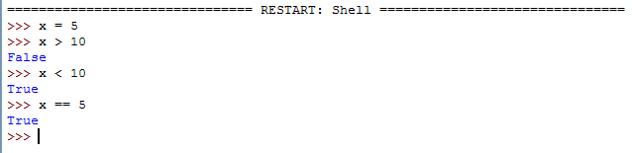
Comparison Operators
Comparison operators return Boolean values abbreviated bool() in Python
Booleans are binary and return only True or False (case sensitive)
In Python, all numbers are True except 0
In Python, all strings are True except a blank string

Slide 7
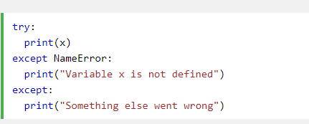
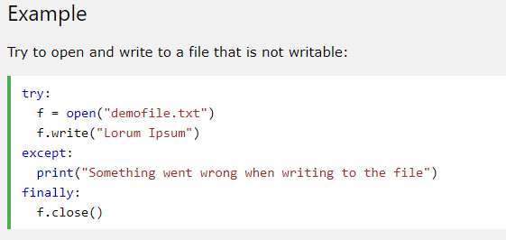
Try Except Finally
Try, Except, finally will also run under certain conditions
Try tests a block of code for errors.
Except block lets you handle the error
Finally block is run regardless of if there was an error or not

Slide 8
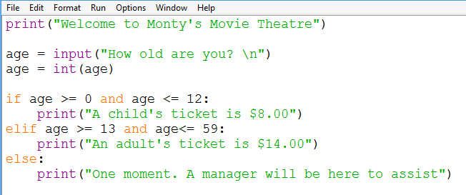
Conditional Statements
Notes:
print("Welcome to Monty's Movie Theatre")
age = (input("How old are you? \n"))
age = int(age)
if age >= 0 and age <= 12:
print("A child's ticket is $8.00")
elif age >= 13 and age<= 59:
print("An adult's ticket is $14.00")
else:
print("One moment. A manager will be here to assist")

Slide 9
String Operators
Operator | Purpose | Input | Syntax | Output
upper() | Converts to Upper Case | name = “Monty” | name.upper() | MONTY
lower() | Converts to lower case | name = “Monty” | name.lower() | monty
title() | Converts to Title case | name = “monty” | name.title() | Monty
len() | Counts number of characters | password = “monty” | len(password) | 5
replace() | Replaces parts of a string | s = “I like my dogs” | s.replace(“like”,”love”) | I love my dogs
Python is case sensitive. “Monty” != “MONTY”

Slide 10
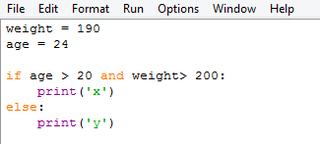
Logical Operators
Combine comparison operators and logical operators to write advance Boolean statements
What does the program below print?
Operator | Syntax
and | age > 40 and weight < 150
or | age>= 40
not | not True

